Slide 1

Start anew

Slide 2
Задачи:
Задачи: развивать лексические навыки, навыки чтения,аудирования и говорения, умения аргументировать ответ

Slide 3
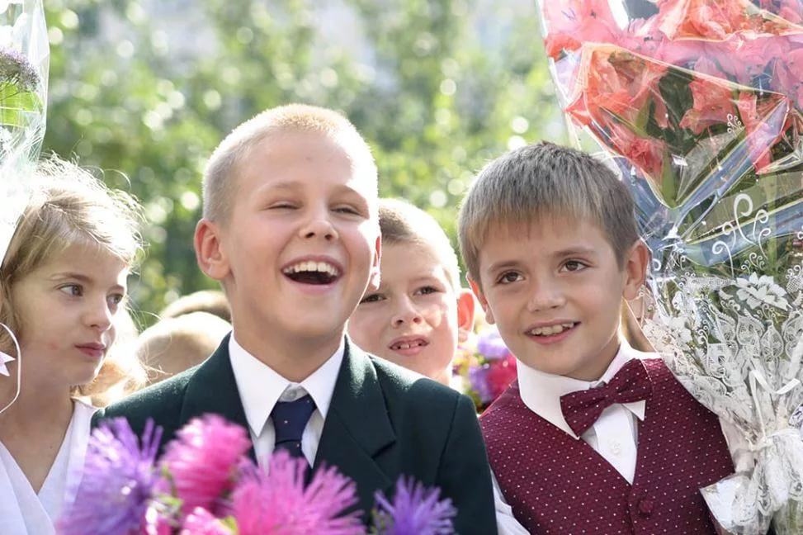
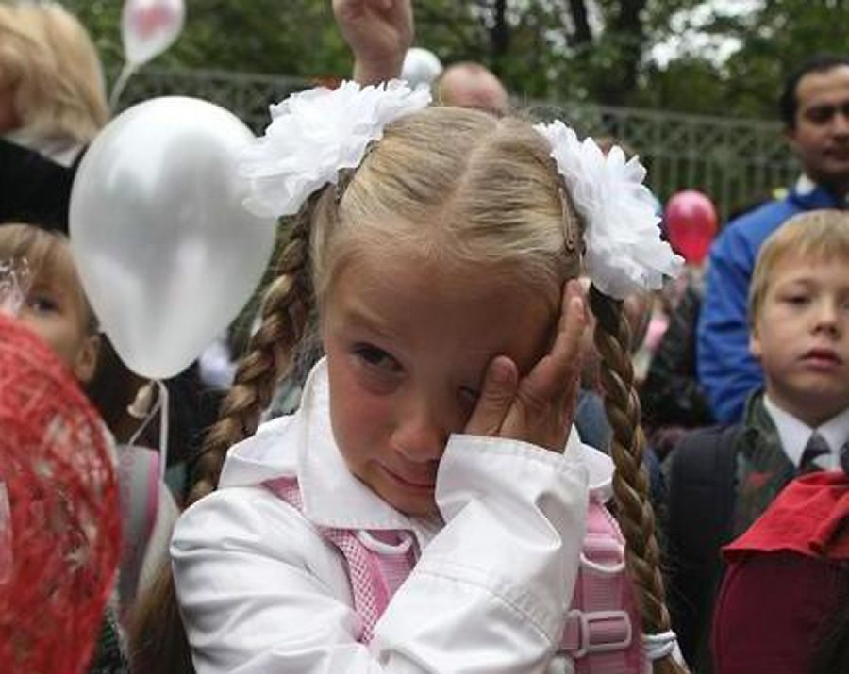

Slide 4
What are we going to speak about?
At this lesson we are going to speak about good and bad things on the first day at school.

Slide 5
Match the words to make up the word combinations
To wear
Previous
Elective
Important
To feel
To please
To make
To learn
Nervous
Discipline
Reason
Uniform
Parents
Friends
Subjects
School

Slide 6
Complete the word web with the words from ex.6 and ex.5
schoolmates
schedule
homework
newcomer
uniform
SCHOOL
Elective subjects
semester
marks
Report card
education
class
knowledge

Slide 7
Use the following phrases
Most of us think that the main reason for going to school is …
We all agree that…
Some people believe that…
There was one person who said…
The least important reasons are…

